Slide 1
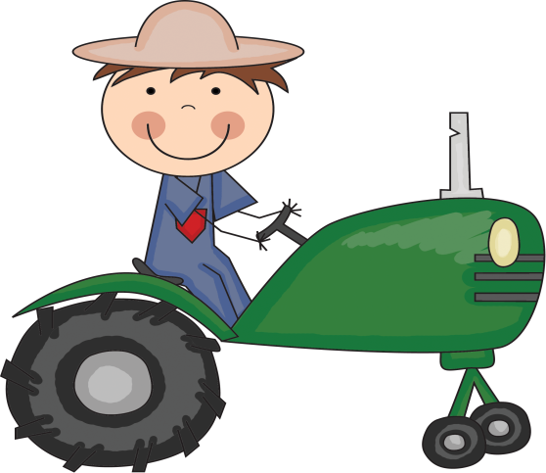
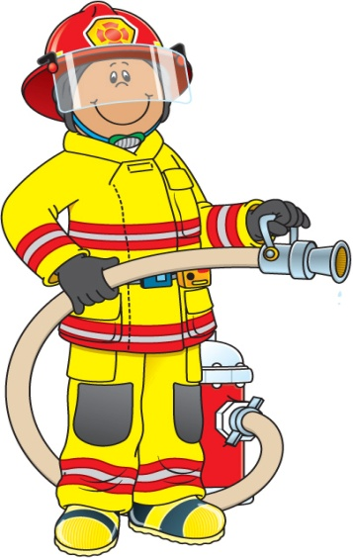
The
Important
Book
About
Goods
and
Services
App. F

Slide 2
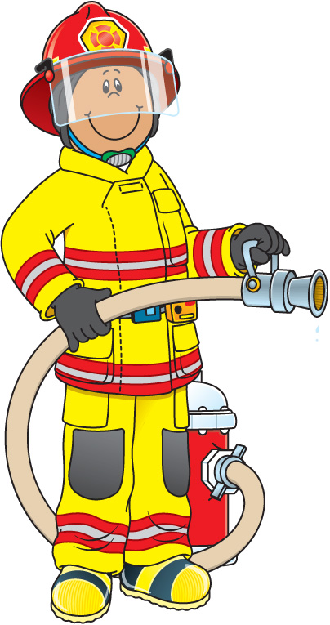
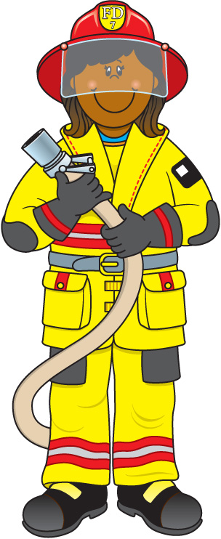
The important thing about firefighters is that they put out fires.
They provide a service.

Slide 3
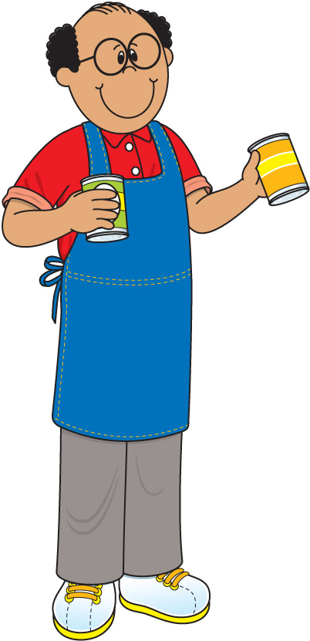
The important thing about grocers is that they sell food.
They provide goods.

Slide 4
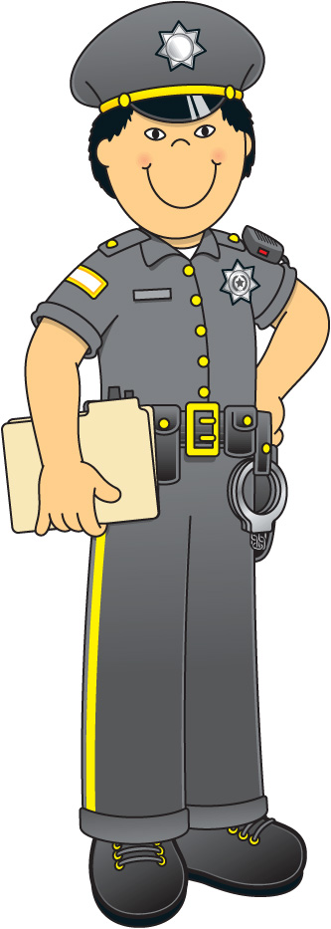
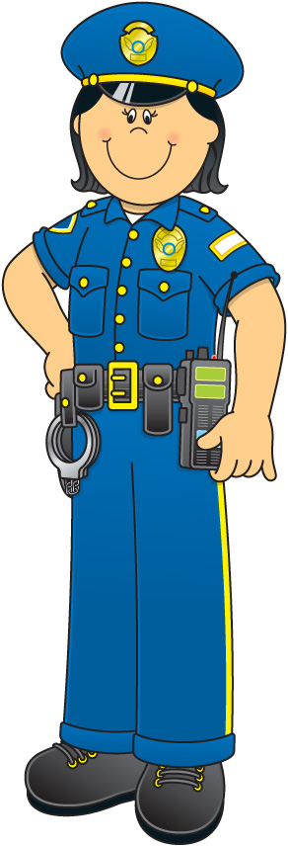
The important thing about police officers is that they keep us safe.
They provide a service.

Slide 5
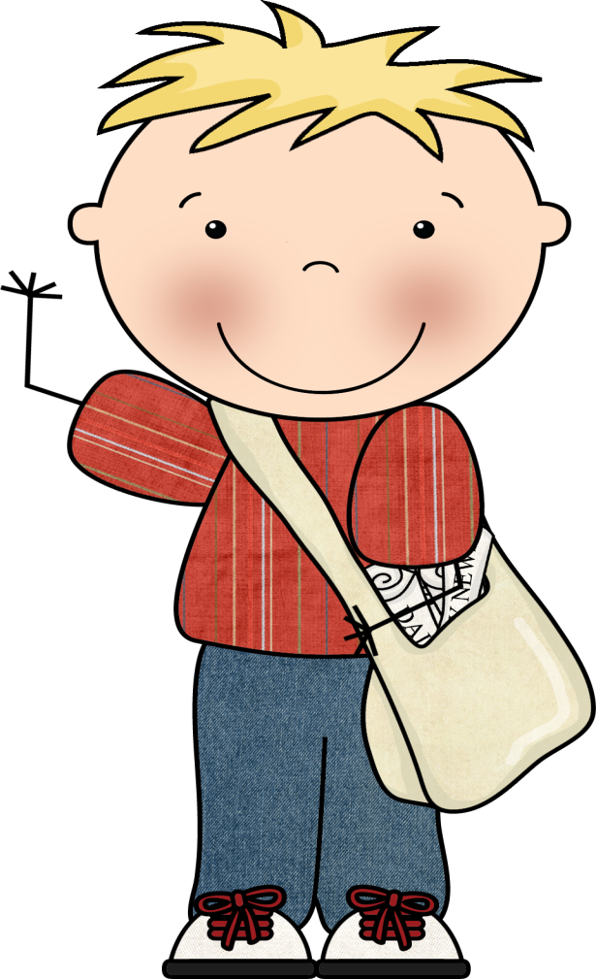
The important thing about newspaper kids is that they provide our newspaper.
They provide goods.

Slide 6
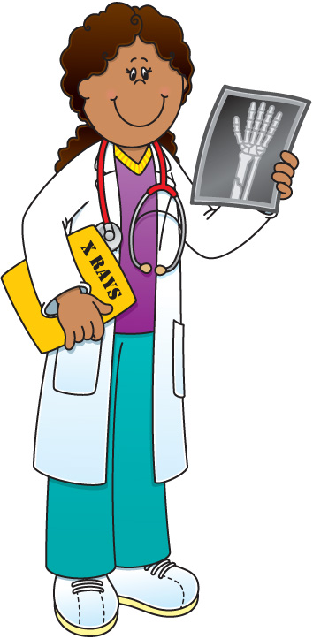
The important thing about doctors is that they keep us healthy.
They provide a service.

Slide 7
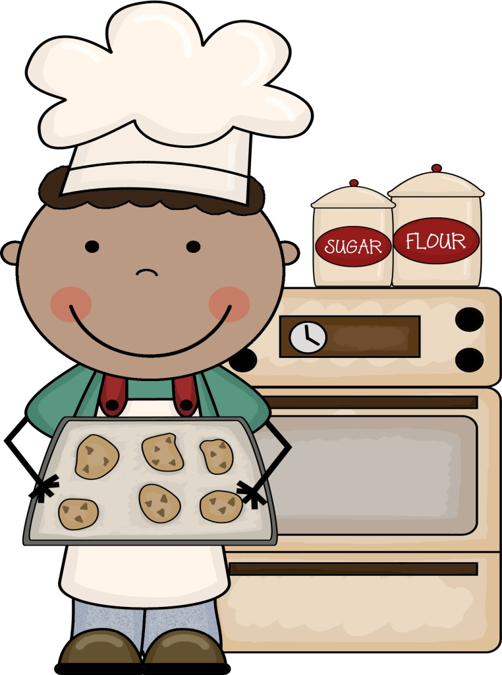
The important thing about bakers is that they provide cookies and cakes.
They provide goods.

Slide 8
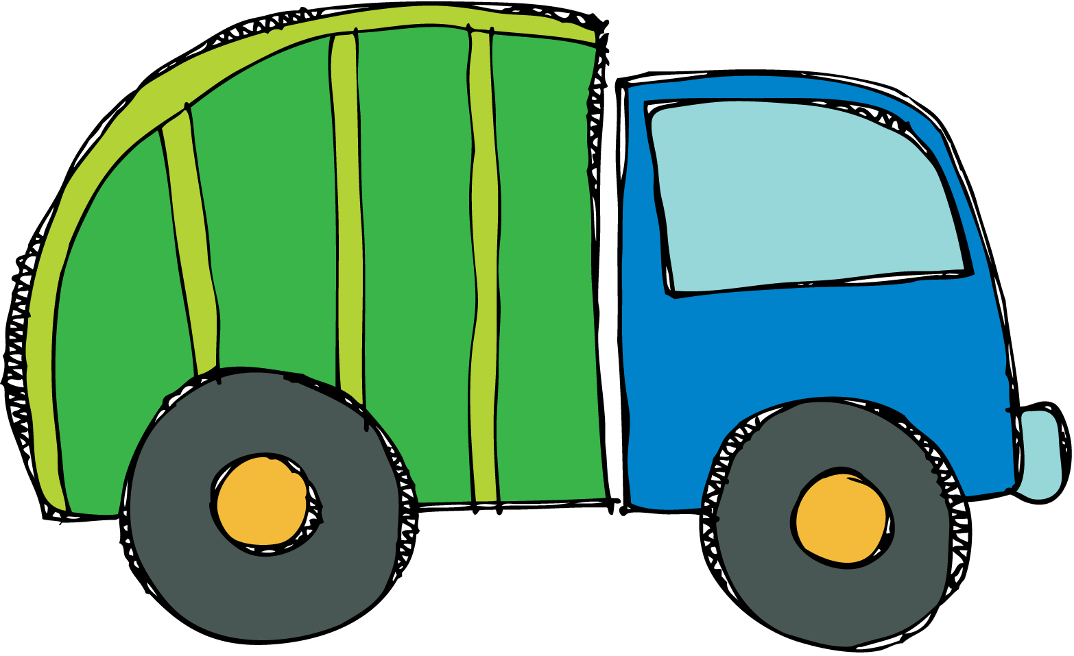
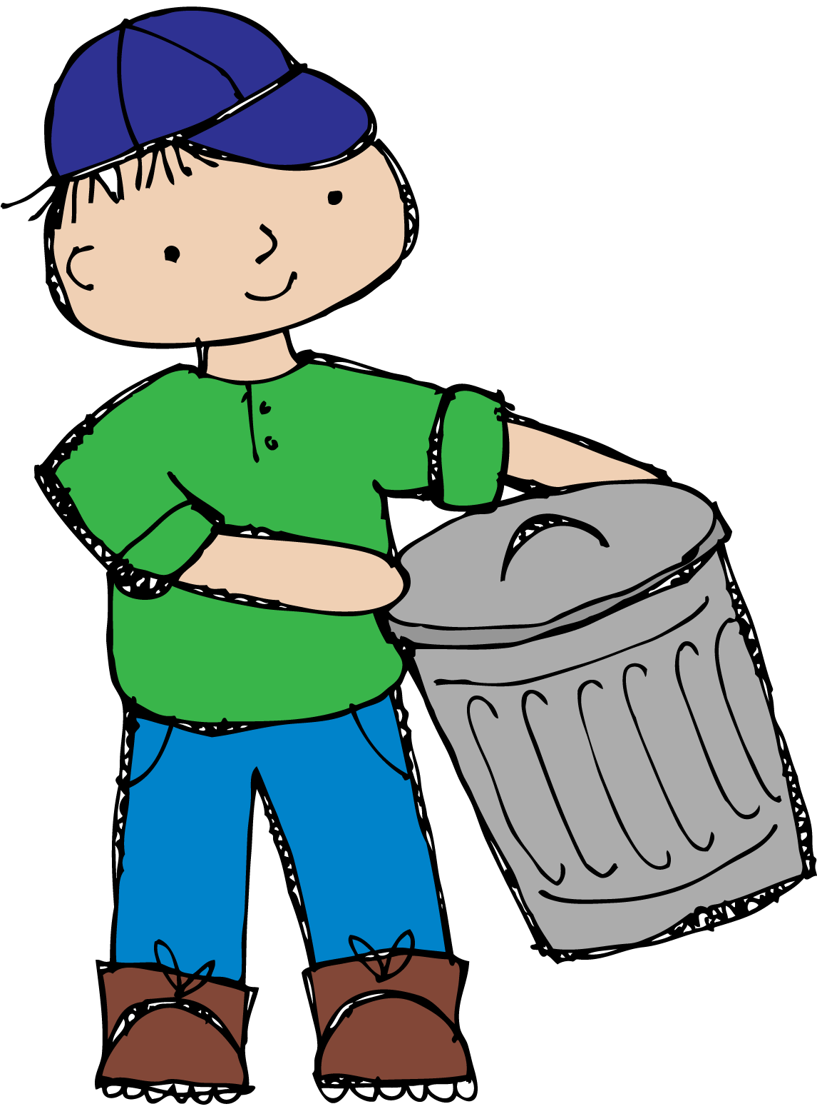
The important thing about garbage collectors is that they get rid of trash.
They provide a service.

Slide 9
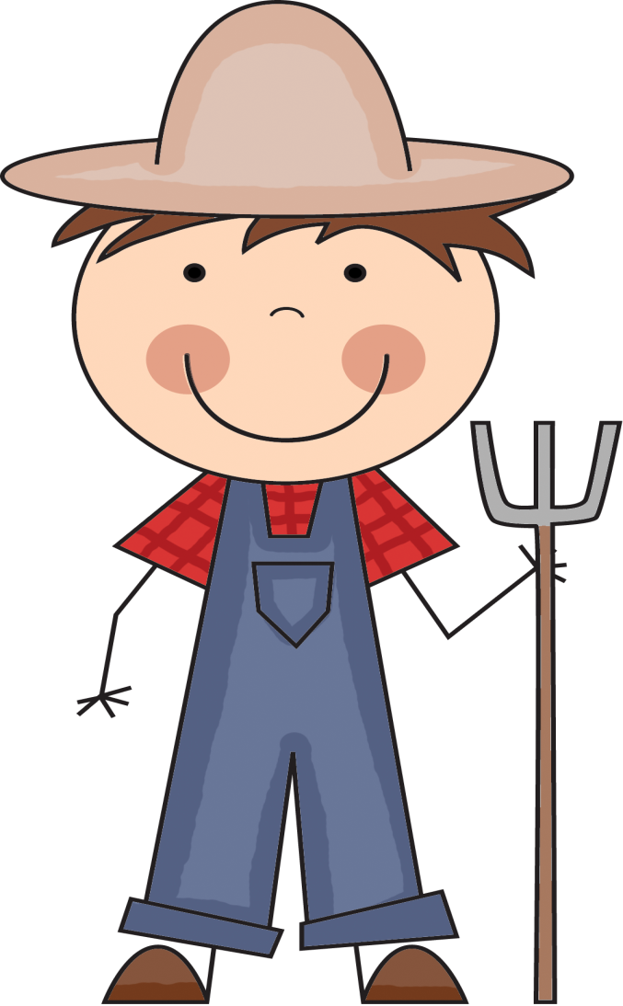
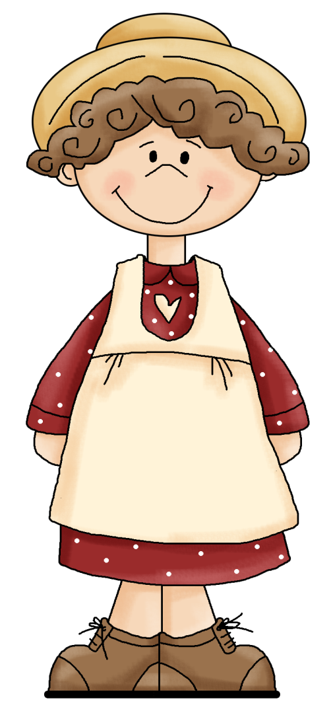
The important thing about farmers is that they grow our food.
They provide goods.

Slide 10
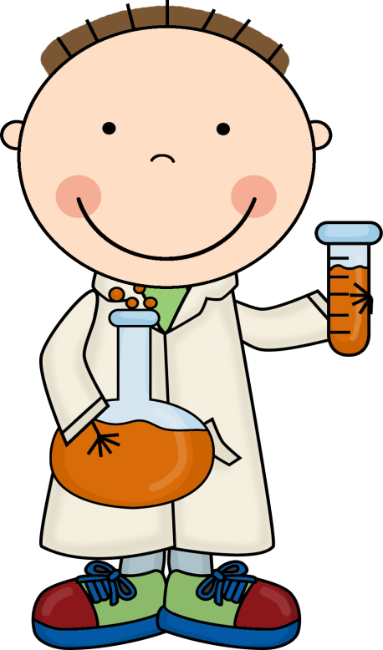
The important thing about inventors is that they
invent so many things!
They provide goods.

Slide 11
The important thing is that you can do anything.
Will you provide goods or services?

